Slide 1
PP4: Meiosis
Year 10 Science

Slide 2
Making gametes
Mitosis is a form of cell reproduction that makes two diploid daughter cells from one diploid parent cell
It is used for growth, repair and asexual reproduction
The ovaries in females and the Testes in males make haploid gametes (eggs and sperm)
Note in plants, the male gamete is pollen. There are also special organs in plants where gametes are made. Pollination by birds or insects is a form of sexual reproduction
Gametes are created by a different form of cell reproduction called Meiosis

Slide 3
Meiosis
Chromosomes double just like in mitosis to form chromatids
Half the chromatids go to one end of the cell, the other half to the other end
Two new cells are made
The chromatids divide again to form FOUR haploid gametes
Q: Why is it necessary to half the amount of genetic information passed on?
A:To increase variation in populations

Slide 4
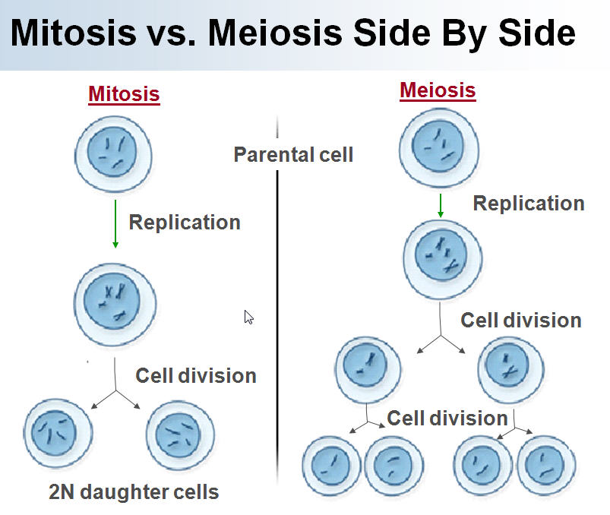

Slide 5

Key terms
Diploid – two sets of chromosomes
Haploid – one set of chromosomes
Somatic cells – all body cells
Gametes – sex cells (eggs, sperm, pollen)
Mitosis – cell division producing 2 diploid daughter cells from one diploid parent cell
Meiosis – cell division producing 4 haploid gametes from one diploid daughter cell

Slide 6
Activity
Worksheet – “DNA, mitosis and meiosis”
Finish Mitosis model

